Slide 1



Finasaan
Asaan Finance - For Everyone.

Slide 2
The Team
Product leads:
Muhammad Hadi Khan - 403388
Muhammad Muzamil Kaleem - 415432
Syed Aman Hussain - 415432
Advisory board:
Advisor: Dr. Farzana Jabeen
Co-advisor: Huzaifa Sarfaraz
Committee members:
  Dr. Aimal Rextin
  Meow meow

Slide 3
Problem:
The financial literacy crisis
Only 21%
16th out of 26
13% of pop.
Of adults have access to formal financial services
Ranking of Pakistan among nations in terms of financial literacy
Holds a formal bank account

Slide 4
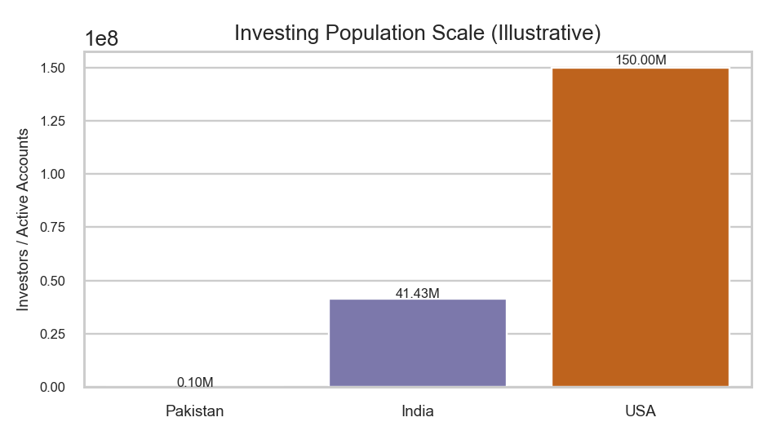
Insurance and investment gaps
  Only 8-10% population has insurance coverage (30-35M policies for 245M people)
  Less than 0.1% participate in stock market (176,355 retail investors)
  Internationally? Way behind.
    USA: 42% of pop. invests
    India: 3%
    Pakistan: 0.04%

Slide 5
So, how do Pakistanis “save”?
  Real estate, DHA plots
  Committee, money pooling
  Savings accounts, or even worse, current accounts or cash.
Issue: Money is still losing value in most cases.

Slide 6
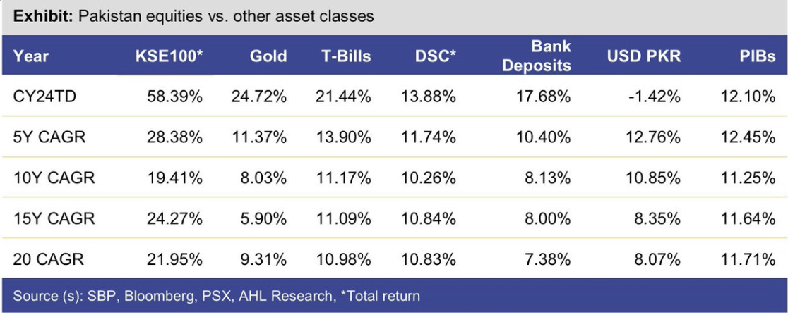
The Opportunity Cost
Pakistani stock market outperformed Gold: The God’s currency.

Slide 7
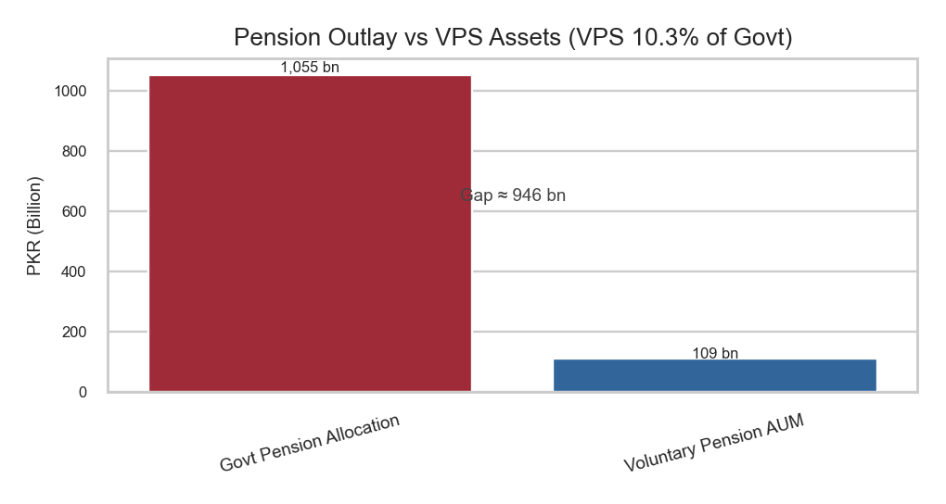
Retirement Planning Emergency
  VPS holds only PKR 109B (0.3% of GDP)
  US 401(k): $7.4 trillion (35% of GDP) with 85% workforce participation
  60 million Pakistani workforce largely without retirement planning
  Government spending large amounts on pension, that can be diverted.

Slide 8
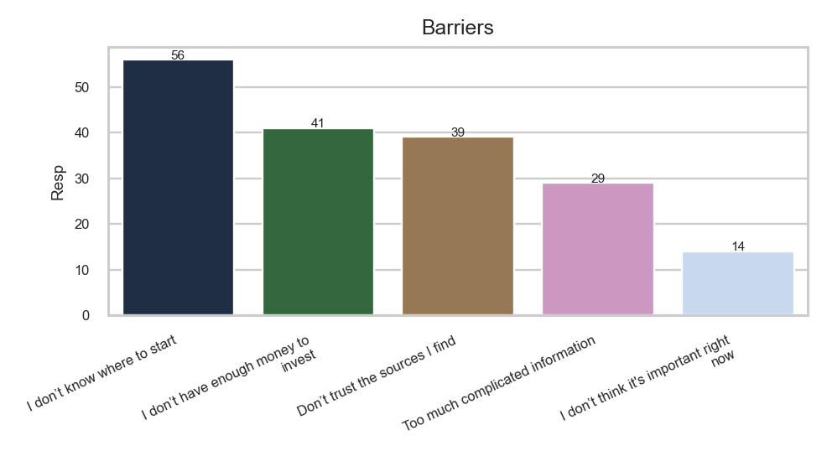
Solution? Help people become financially literate.
  200+ survey respondents (18-24 age group)
  75% want to invest but lack knowledge
  Top barriers: "Lack of Knowledge" (40%), "Don't Know Where to Start" (35%)

Slide 9



Dual-interface approach (Beginner & Advanced)
PSX, Mutual Funds, Insurance, all in one learning
Presenting:
Finasaan
AI-powered personalized learning
Adaptive learning based on user proficiency

Slide 10
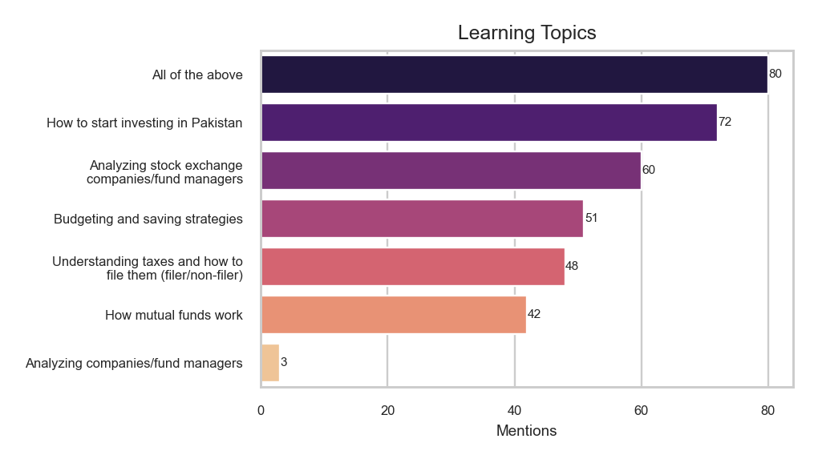
User requirements

Slide 11
01. Stock Exchange
Core Features & Modules
02. Mutual Funds
Finasaan aims to provide ease of learning with the following modules.
The aim is to provide these features for an existing retail investor and also someone who is about to start.
03. Insurance
04. Calculators
05. Taxation

Slide 12







Tech stack
Frontend - NextJs
Backend - HonoJs
Database - MongoDB / Pinecone / PostgresQL
AI- Gemini / Groq
CDN / Deployments / Security - Cloudflare
(or multi-cloud)
Design - Figma

Slide 13
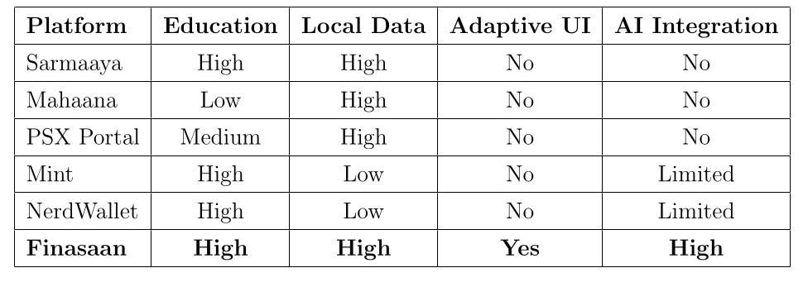
Competitive Analysis
Finasaan will be Pakistan’s first : fully digital, fully personalized, research and learning platform.

Slide 14
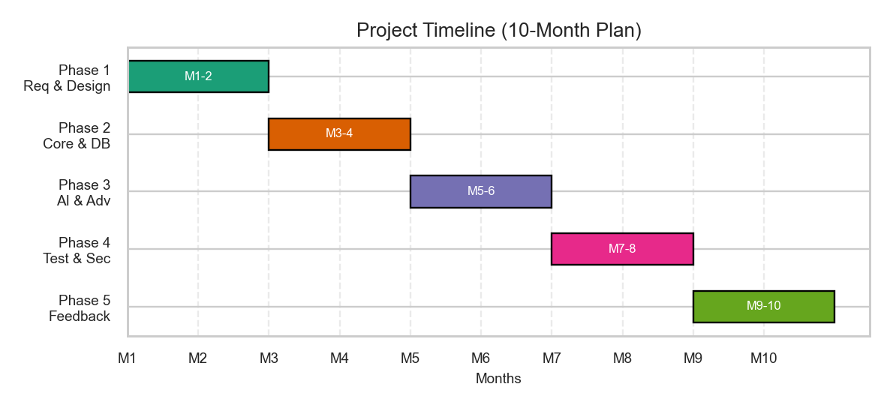
Implementation Timeline
Starting from July - 2025 till May 2026

Slide 15
Team: Work Division
Hadi
Muzammil
Aman
Full stack development and DevOps
Fullstack development of core application
Lead UI/UX designer, frontend developer

Slide 16
Methodology
1- Design
2- Scrape
3- AI architecture
Featuring a design first, non-overwhelming appraoch
Fetch data from sources like PSX, MUFAP, etc.
Create an architecture to have contextual data based on user knowledge

Slide 17
Methodology
4- Backend
5- Frontend
6- Chatbot
Design APIs, microservices, schema
Build adaptive UI for all type of screens
Chatbot for all users to get a 1-1 financial literacy helper.

Slide 18



Impact
TAM - 140 million
SAM - 73 million
SOM - 733K
Adult Population in Pakistan
Number of people with a smart phone
1% of SAM

Slide 19

SDG 4: Quality Education
UN SDGs
SDG 8: Economic growth via financial inclusion
Finasaan is built to empower people.
SDG 9: Industry, innovation and infrastructure
SDG 10: Reduced Inequalities

Slide 20
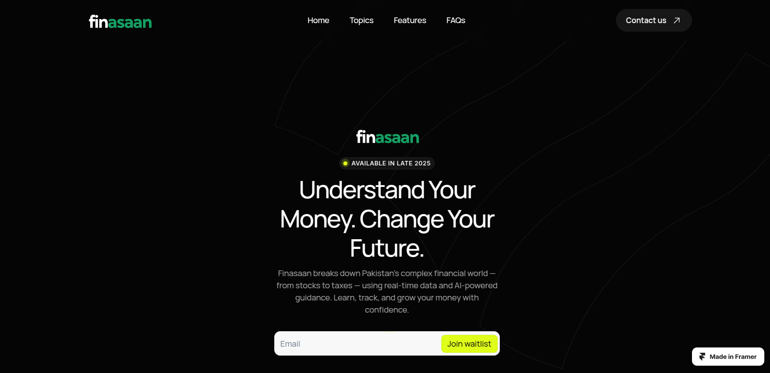
Design-first appraoch

Slide 21
Thank you.

